Slide 1
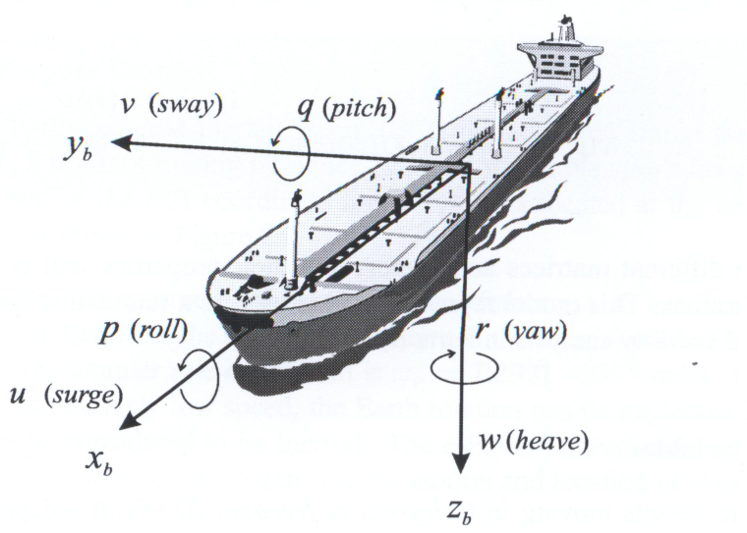
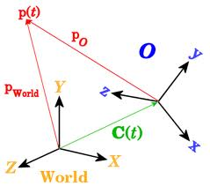
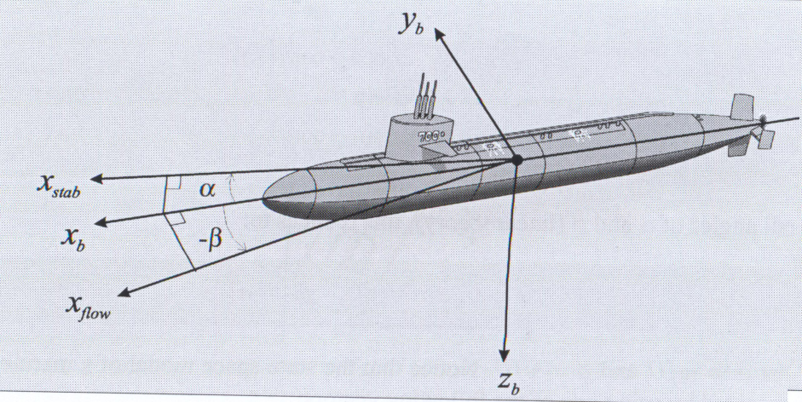
Topic # 2 Coordinate Transformations and Kinematics of Motion

Slide 2
Outline of the Chapter
Coordinate frames
True Inertial Coordinate Frame {I}
Earth-Centered-Inertial Frame {i}
Earth-Centered-Earth-Fixed Frame {e}
Geodetic Coordinate System {λ, φ, h}
Tangent Plane Coordinate System {u}
Navigation Coordinate System {n}
Body-Fixed Frame {b}
Major coordinate transformations
Geodetic to ECEF Coordinate Transformation
ECEF to Tangent Plane Coordinate Transformation
Tangent Plane to Body Coordinate Transformation
ECI to ECEF
Differential rotations
Coriolis theorem

Slide 3
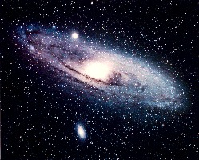
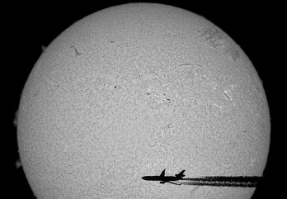
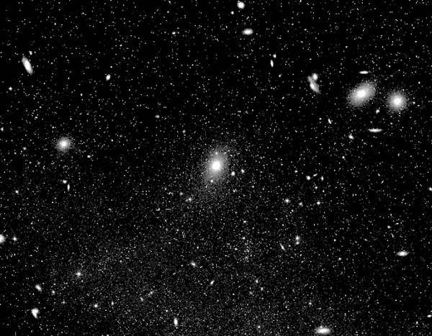
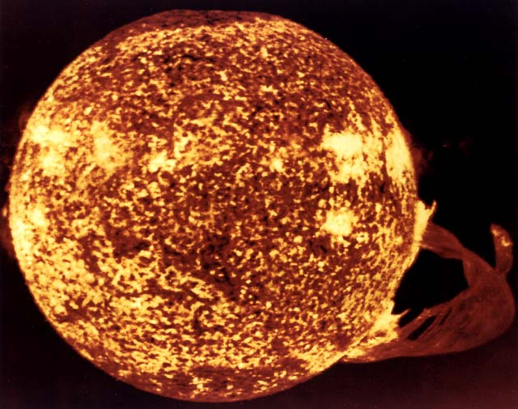
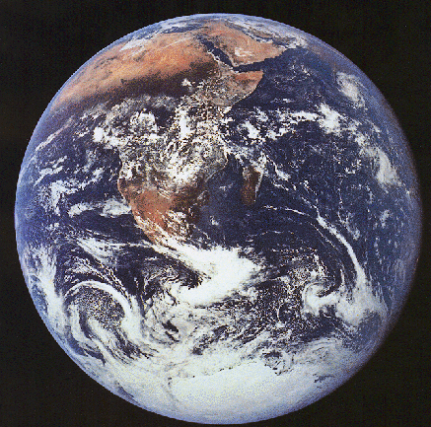
True Inertial Coordinate Frame {I}
Inertial space – absolute motion is zero.
Inertial frame – a set of orthogonal axis that do not accelerate or rotate.
!! It is an abstraction !!
V=2.5^{x}10⁵m/s
r=2.7^{x}10²⁰m
=2^{x}10⁻⁷s⁻¹
d=3^{x}10¹¹m
=7.3^{x}10⁻⁵s⁻¹
r_{e}=6.4^{x}10⁸m

Slide 4
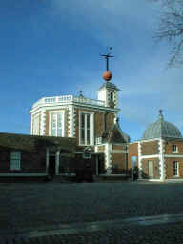
Earth-Centered-Inertial {i} & Earth-Centered-Earth-Fixed {e} Frames
Coordinate frame={Origin, Alignment and Connection of Axis}
Nature gave no clear direction on selecting the Prime Meridian, as it did with the equator as the 0 degree of latitude. (Half-way between the poles.)
As late as 1881, there were 14 different prime meridians still being used on topographic survey maps alone. The International Meridian Conference of 1884 adopted the Prime Meridian line passing through the Greenwich Observatory near London, England.
“Fixed” remote star {I}
Greenwich Mean Time (GMT) defined at the Royal Observatory Greenwich

Slide 5
Latitude, Longitude and Altitude
Latitude runs from 0° at the equator to 90°N or 90°S at the poles. These lines of latitude, called parallels, run in an east-west direction.
Lines of longitude, called meridians, run in a north-south direction intersecting at both poles. Longitude runs from 0° at the prime meridian to 180° east or west, halfway around the globe.

Slide 6

Local Geodetic Coordinate System {λ, _{n}, h}
Earth reference ellipsoid
Geocentric latitude _{c}
Astronomical latitude _{g}
Geodetic latitude _{n}= 
Plumb line
Tangent plane
P
_{c}
_{g}
_{n}
0
Equator
0
Equator
0
Equator
Earth surface
Earth surface
Earth surface

Slide 7
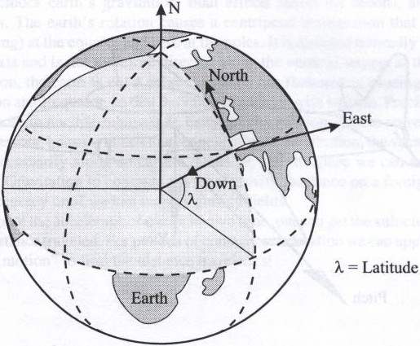
Tangent Plane {u} and Navigation {n} Frames
Earth's axis of rotation
North pole
x
z
y
_{n}=  - latitude
North slaved mechanization has singularity at the Pole

Slide 8
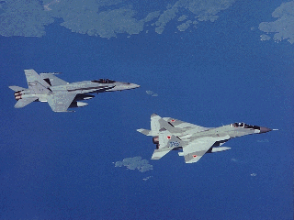

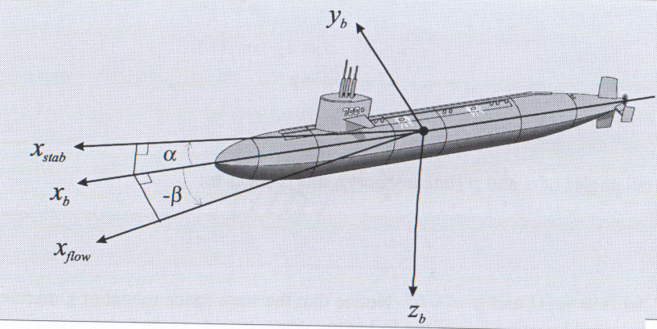
Body-Fixed Frame {b}
x (roll)
y (yaw)
x (roll)
y (pitch)
z (yaw)
z (pitch)

Slide 9
Major and Auxiliary Transformations
Geod.{,_{n},h}
,_{n},h
ECI {i}
ECEF {e}
LTP {u}
₀,_{ei},t
,_{n}
Earth
Moving vehicle
Body {b}
Nav. {n}
,θ,

Gyros {g} &
Accelerometers {a}
Platform {p}
W.-Az. {c}

Slide 10
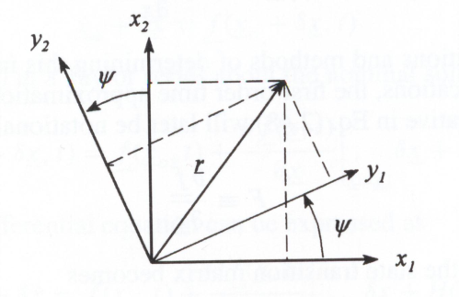
Coordinate Transformation: One Angle Rotation
r - is the same vector in both frames
Calculate components of r in the rotated frame.
x₂
Rotated frame
Original frame
y₂
y₁
x₁
Key properties of DCM
Three axis case
A.
B.
C.
D.

Slide 11
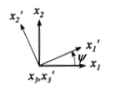
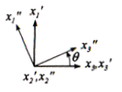
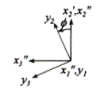
Three Angle Rotation
Rotation 1 (RHCartesian)
Observations
The transformed vector components along the axis of rotation remain unchanged with the rotation about that axis; elements of DCM r/c are either 0 or1.
The remaining element of DCM are either sin() or cos() of the angle of rotation .
cos() elements are on the diagonal with sin() elements on off-diagonal.
Negative sin() components corresponds to the component rotated “outside” of the quadrant formed by the original frames.
Rotation 2
Rotation 3
Combining the sequence into a single rotation matrix
results in

Slide 12
Derivative of a Rotation Matrix
One of the key question is to determine the dynamics of the state. This involves calculating the derivative of the rotation matrix.
The last equation allows expressing the time derivative of R(t) as a function of R(t) itself.

Slide 13
What is the Skew-Symmetric Operator
Consider an elementary rotation with respect to z-axis:
For a general 3-angles rotation sequence:

Slide 14
Derivative of a DCM
Consider small rotations from one frame to another using infinitely small angles; keep first order terms and neglect any higher order terms:
Small rotations are completely decupled and the order of small rotations does not matter!
first order expansion
general solution
DCM derivative

Slide 15
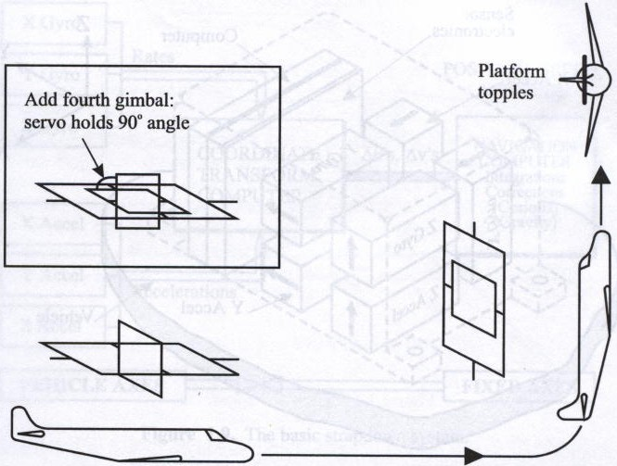
Transformation of Angular Velocities
! Gimbal lock

Slide 16
ECI 2 ECEF
Earth Sidereal Rotation Rate
GRS-80 and WGS-84
GRS-67 and WGS-84 for time definition
WGS-84 in precessing frame for satellites application

Slide 17
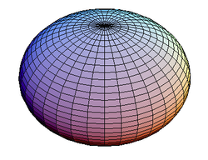
Earth Model
Oblate spheroid
flattening (0)
eccentricity (0)
ellipticity (∞)
2nd eccentricity (0)

Slide 18
Geodetic 2 ECEF Coordinate Transformation

Slide 19
ECEF 2 Tangent Plane Coordinate Transformation
R

Slide 20
Euler Angles
z˝
z^{n}=z´
z^{b}
0
y^{b}
x^{n}
x´
y´=y˝
y^{n}
x˝=x^{b}
roll pitch yaw

Slide 21
Euler Angles Resulting from Rotation Matrixes

Slide 22
Rigid Body Equation
Y_{i}
z _{r}
M
q
y _{r}
ω
O
X_{i}
x _{r}
Rotating frame
Z_{i}
Non-rotating frame

Slide 23
Coriolis Theorem
Y_{i}
z _{r}
M
B
y _{r}
ω
O
X_{i}
x _{r}
Rotating frame
Z_{i}
Non-rotating frame
Coriolis Theorem states that the absolute time rate of change of a vector r = xi + yj + zk where the reference frame {I,j,k} rotates with absolute angular velocity ω = pi + q j + rk is :
dr/dt = ( dx/dt i + dy/dt j + dz/dt k ) + ωx r

Slide 24
Example:: General Motion Equations
Y
Q
y
p
z
r
x
P
R
ω
O
Z
X
Coriolis
Centripetal

Slide 25
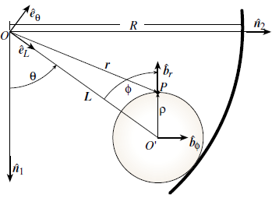
Example:: Disk Rolling Inside of a Circular Tube
What is the inertial acceleration of point P?
Solution:
1.
When differentiating r twice the following angular velocities will be required:
no “slippage”
2. Find relations between the angular velocities
L- length of the connecting rod
ρ - radius of the disk
The connecting rod and the disk are rigid.

Slide 26
Example:: Disk Rolling Inside of a Circular Tube
3. Apply Coriolis theorem to get an inertial speed:
no “slippage”
4. Apply Coriolis theorem second time to obtain an inertial acceleration:

Slide 27
Closing Notes
True Inertial Coordinate Frame {I}
Earth-Centered-Inertial Frame {i}
Earth-Centered-Earth-Fixed Frame {e}
Geodetic Coordinate System {λ, φ_{n}}
Tangent Plane Coordinate System {u}
Navigation Coordinate System {n}
Wander Azimuth Coordinate System {c}
Body-Fixed Frame {b}
Coordinate transformations
Euler angles and DCM
Derivative of DCM
Transformation of Angular Velocities
Major Coordinate transformations
Coriolis Theorem

Slide 28
Your Next Lab Assignment
4. Interactive Control Systems Tutorial ( http://www.mathworks.com/academia/student_center/tutorials/controls-tutorial-launchpad.html# .
This more practical tutorial introduces you to the use of MathWorks tools for modeling dynamic systems. It includes a section on using Simulink Control Design™ for designing and analyzing control systems modeled in Simulink. Select sections based on your experience with control design. You can download files of the examples featured in this tutorial ( you can find them in a share drive).
System Representation (25 minutes) - Learn the basics of representing dynamical systems in MATLAB and Simulink.
Introduction to System Representation 3:05 -Review how to model differential equations in Simulink.
Linear Time-Invariant Systems 12:15 - Learn the basics of representing LTI systems in MATLAB.
Simulink Block Diagrams 10:34 - Learn the basics of modeling and simulating LTI systems in Simulink.
System Analysis (35 minutes) - Learn to analyze LTI systems using Control System Toolbox.
Introduction to System Analysis 2:19 - Review example systems and where to find help for Control System Toolbox.
Time Domain Analysis 19:15 - Obtain transient response characteristics of first-order and second-order systems and relate them to system parameters.
Frequency Domain Analysis 14:16 - Compute system responses to sinusoidal inputs and obtain Bode diagrams.
Control Design (65 minutes) - Design and implement common compensator structures in MATLAB and Simulink.
Introduction to Control Design 3:01 - Explore why feedback controllers are used in real-world applications.
Analyzing Closed-Loop Systems 23:45 - Apply open-loop techniques such as root locus and understand how closed-loop systems respond to external disturbances.
Implementing Common Compensator Structures 20:03 - Model and tune common compensators to meet design requirements.
Designing Compensators in Simulink 21:10 - Apply a control design workflow to model, tune, and verify controllers in Simulink.

